Slide 1
Introduction to Git
A versioning control system
Notes:
Presenter introduction and recent background

Slide 2
Overview
Overview of version control
Version control technologies
Git
Terminology
Important files/folders
Common git commands
Demonstration
Security Issues
Q&A
Notes:
It is my intention to get you to start using git, if only using basic commands.

Slide 3
Description of Version Control
“In software engineering, version control (also known as revision control, source control, or source code management) is a class of systems responsible for managing changes to computer programs, documents, large web sites, or other collections of information. Version control is a component of software configuration management.”
Wikipedia.org
Notes:
In other words, it’s one or more programs that allow us to manage and retrieve changes to code files

Slide 4
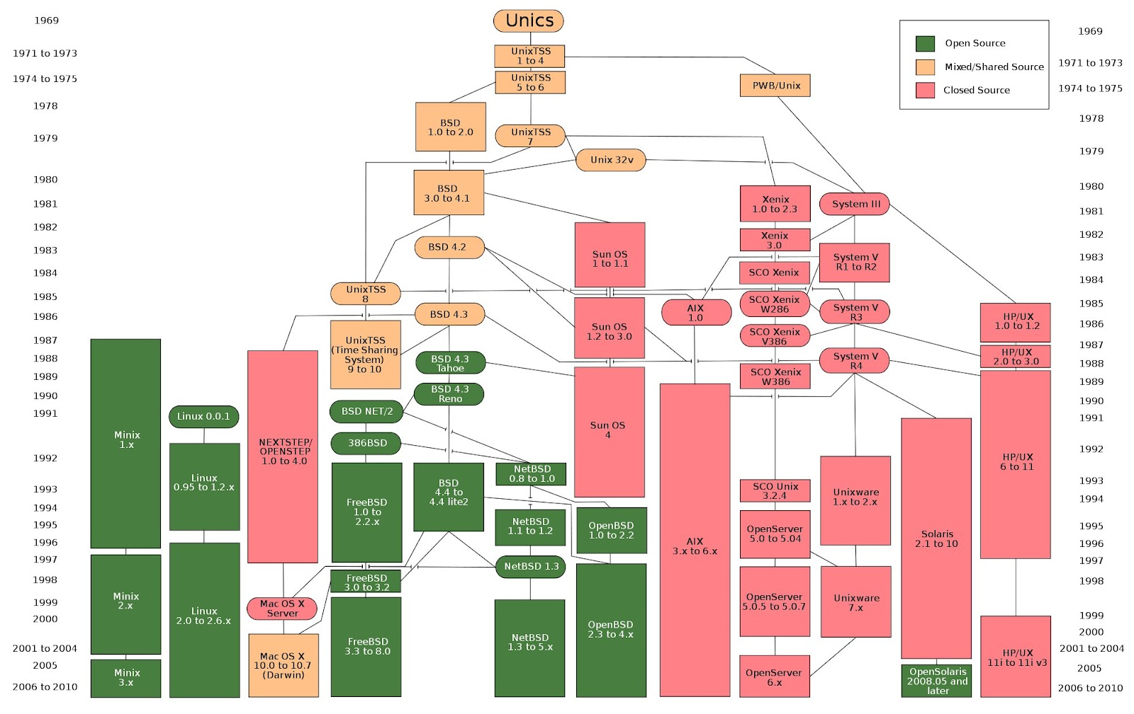
Notes:
Source: https://en.wikipedia.org/wiki/File:Unix_history-simple.svg for entry
https://en.wikipedia.org/wiki/Unix-like
This is an image of UNIX and UNIX-variants over time
The reason why I inserted this is to show how a project can progress over time.

Slide 5
Version Control Technologies
git
rcs
cvs
Microsoft Teams Foundation Server (now Azure DevOps Server)
Notes:
RCS – Revision Control System – is a command-line tool on FreeBSD that allow tracking of changes by system administrators, usually.
CVS – Concurrent Versions System – is a GNU open-source command-line tool
OpenBSD still uses it, but they may be transitioning to git
Azure DevOps Server has a trial version, but otherwise, it’s generally for enterprises.

Slide 6
git
git was created by Linus Torvalds to manage Linux kernel revisions
It’s a command-line tool; however,
JetBrains has UI integration into git
Visual Studio
And others
Common repository servers:
GitHub.com
GitLab
Notes:
Although these are the two common repository servers, they are not the only options.
GitHub.com is primarily free because enterprises can have paid hosting.
GitLab isn’t as common because the tool can be more verbose than user’s like.
Private cloud hosting is an option

Slide 7
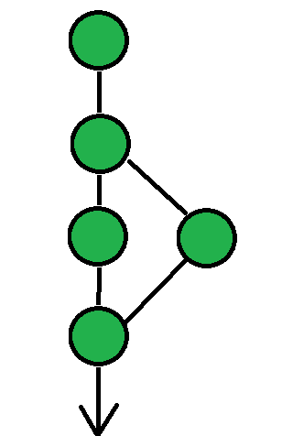
Terminology
Repository (or repo) – a filesystem database that manages/tracks changes
Think of this like a timeline
Local
Remote
Branch - a “fork” in the timeline
Test new features before applying to main
Separate code
Compare branches
Other contributors may create commits in a separate branch then perform unit testing before merging with “main”
Other reasons
Commit - a point in time when the author(s) saved changes to the repository
Log – a human-readable report of each commit
HEAD – This is a special commit name, usually the current commit
Notes:
I use the terminology of local and remote mainly because a remote repository could be one of the following:
A remote server resource
A separate filesystem path
And you:
Push to a remote repository, to add commits
Pull from a remote repository, to update/sync the local repository with the remote
When I say local repository, I always mean the repository located on the local/client filesystem, which a contributor is editing.

Slide 8
Important files/folders
.git/
Located in the project’s root
DO NOT DELETE
This is why (git for) Windows marks it as a hidden and system folder
macOS, et al. no such safeties
.gitignore
Also located in the project’s root
Acts as a filter to exclude files or folders
$HOME/.gitconfig
On Windows, HOME is the user’s profile “echo %USERPROFILE%”
Global variables for git
Contains user’s name and email information
.git/config
This is like the global .gitconfig above, but it’s for project/repo variables

Slide 9
Common git Commands
init
This command initializes the repository
Creates .git/ in the project’s root directory/folder
log - This command prints out the commits and their commit messages
clone - This command copies (or clones) a repository from a remote location
add - This command stages files for committing
commit - This command commits the staged files to the repository and updates the log
pull - Pull commits from a remote repository
push - Push commits to a remote repository
status
Report on changes to the repository – this includes: pending commits (staged files), new files/folders excluding patterns from .gitignore
Notes:
This is not an exhaustive list. These are the primary commands that a beginner should learn, IMO.
For a listing of some commands, execute “git --help”
Other, more “intermediate” commands include – but are not limited to the following:
reset – This command needs to be used sparingly, but it may be needed to revert changes
rm – This deletes a file from the repository and schedules the change for a commit
mv – This moves a file around in the repository and schedules the change for a commit
branch – This makes changes to branches, like creating or deleting
checkout – This allows a user to checkout a commit or branch. It is strongly recommended to checkout previous commits to a new branch to avoid “detached HEAD states.”
config – This command manages .gitconfig (via –global flag) and .git/config variables
remote – Modify settings for remote repositories

Slide 10
Demonstration

Slide 11
Security Issues
Hardcoded passwords (passwords embedded in the source code) are a no-no
Alternatives:
Read from a password file that’s listed in the .gitignore = OK
Read from a password file outside the project = Better
Prompt for the password (it may be a nuisance during testing, if so use the password file) = Best
Other information leaks
Refrain from committing sensitive information, even if it’s an image
Notes:
Although I’ve never tried to remove a complete file’s history from a git repository, it may be possible, but act like you can’t to avoid an information leak

Slide 12
Q&A

Slide 13
Thank you
Matthew Markfort
Computer Science student at Metro State University

